Slide 1

UNIVERSITY OF COMPUTER STUDIES, PATHEIN
Presented Report on
Blood Donation System
Group(II)
Supervised By:
Dr. Khin Lay Thwin
Professor
Co-supervised By:
U Kaung Htet Oo
Lecturer
Faculty of Computer Science
05-09-2024

Slide 2
Blood Donation System

Slide 3

Presented By
Ma May Thandar Htun(Leader) VIIICS-5
Ma Nyein Htet Htet Kyaw VIIICS-4
Ma Su Shwe Zin VIIICS-11
Ma Chuu Eain Si VIIICS-12
Mg Htet Soe Wai VIIICS-16
Mg Kyaw Zin Thu VIIICS-24
Ma Chit Su Maung VIIICS-26
Ma Su Myat Lwin VIIICT-2
Mg Htet Myat Moe VIIICT-3
Mg Nyan Lin Set VIIICT-6

Slide 4
Table of contents
Introduction
Background Theory
Sever Site
Client Site
Implementation
Conclusion
References

Slide 5
Introduction
Develop Distributed System: Create a system for managing blood donations and requests using CORBA.
Server-Site Operations: Register donations and fulfill blood requests.
Client-Site Functions: Search for blood types, request blood, and donate blood.
Streamline Processes: Ensure efficient handling of blood resources.
Blood Bank Management System
Crucial in Healthcare: Ensure blood availability for patients.
Overcome Challenges: Address data consistency, real-time updates, and resource management issues.
Leverage RMI: Build a distributed system for efficient blood management.
Core Features: Search for blood types, Request donations, Record donations

Slide 6
Background Theory
Distributed System
Connect Independent Computers: Form a network of independent computers working together to achieve a common goal.
Share Resources: Distribute resources like data and processing power across multiple nodes.
Enable Concurrent Operation: Run tasks simultaneously, even across nodes in different locations.
Ensure Effective Collaboration: Coordinate nodes to handle tasks and share resources efficiently.
Manage Key Challenges: Overcome challenges like communication, synchronization, and resilience across the distributed network.

Slide 7
Background Theory(cont’d)
Application of Distributed Concept
Separate Client and Server: Allow the client to handle user interactions while the server manages data processing and storage.
Enable Concurrent Access: Allow multiple clients to donate or request blood simultaneously, with the server efficiently handling each request.
Facilitate Communication: Use CORBA to ensure seamless operation between the client and server, regardless of platform differences.
Distribute Workload: Have the server process requests, manage the database, and ensure data consistency, while the client focuses on providing a user-friendly interface.

Slide 8
Background Theory(cont’d)
Understanding RMI
Allow Communication: Enable objects in different Java Virtual Machines (JVMs) to communicate and call methods on each other as if they were on the same machine.
Facilitate Method Calls: Permit method calls between objects located on different computers over a network.
Simplify Network Communication: Hide the complexity of network communication, making it easy for developers to use remote objects like local ones.
Utilize Stubs and Skeletons: Manage method calls and responses using stubs (client-site representatives) and skeletons (server-site handlers).
Enable Distributed Communication: Use RMI in distributed systems to facilitate communication between parts of an application running on different machines.

Slide 9
Background Theory(cont’d)
What is Common Object Request Broker Architecture (CORBA)
Enable objects to make requests and receive responses transparently.
Operate on any platform, located anywhere on the internet, and written in any language with IDL mapping.
Utilize the Object Request Broker (ORB) as the Object Manager in CORBA.
Build on a middleware-based architecture.
Facilitate remote method invocation for distributed objects
Ensure that objects can interact without knowing their physical locations.
Abstract underlying system complexities from developers.

Slide 10
Background Theory(cont’d)
CORBA interfaces
Provide functionality required by clients or servers.
Dynamically invoke CORBA objects that were unknown at implementation time.
Facilitate the creation of generic CORBA servants.
Use the API to register object implementations on the server side.

Slide 11
Background Theory(cont’d)
Two Major Tasks of ORB’s
Marshalling: the ORB makes sure that the called method receives the parameters over the network correctly.
Un-Marshalling: the ORB also makes sure that the calling component receives back the return values, if any, from the called method.

Slide 12
Sever Site
Database Management
Stores donor details, blood inventory, donation history, requests.
Tables for donors, blood types, donations, requests, inventory.
Unique NRC IDs, inventory updates, expiration tracking.
Request Handling
Handles donor login, registration, blood type search, requests.
Verifies credentials, updates data, manages inventory.

Slide 13
Sever Site(cont’d)
CORBA Middleware Integration
Handles remote calls, cross-platform communication.
Serve authentication, registration, inventory, requests.
Interface defined with CORBA IDL, accessible to clients.

Slide 14
Client Site
Blood Donation Module
Login: Donors log in using their NRC card number, which the server verifies and returns the donor’s profile.
Register Donation: Fill out a form to register donation details; information is sent to the server for processing and storage.
View Donation History: Retrieve past donation records, including dates and blood types, from the server.

Slide 15
Client Site(cont’d)
Blood Request Module
Search Blood Type: Request the server to check availability of a specific blood type and return results.
Request Blood: Submit a request form for desired blood type; the server processes the request and updates inventory.
View Blood Inventory: Check real-time inventory of available blood types, retrieved from the server’s database.
View Inventory History: Access historical data of blood donations and requests, including donor contributions and request fulfillment.
Check Blood Status: Verify the viability of blood units to ensure they are safe for use.

Slide 16
Client Site(cont’d)
User Interface & Experience
User-Friendly Interface: Simple and intuitive forms designed for easy navigation and error reduction.
Technology: Built with Java Swing for the GUI, communicates with the server using CORBA.

Slide 17
Implementation
Define the CORBA interfaces using IDL
Generate Stub and Skeleton Classes
Implement Server-Site Methods
Initialize ORB and Register with Naming Service
Client-Site Interaction
Start ORB and Naming Service

Slide 18
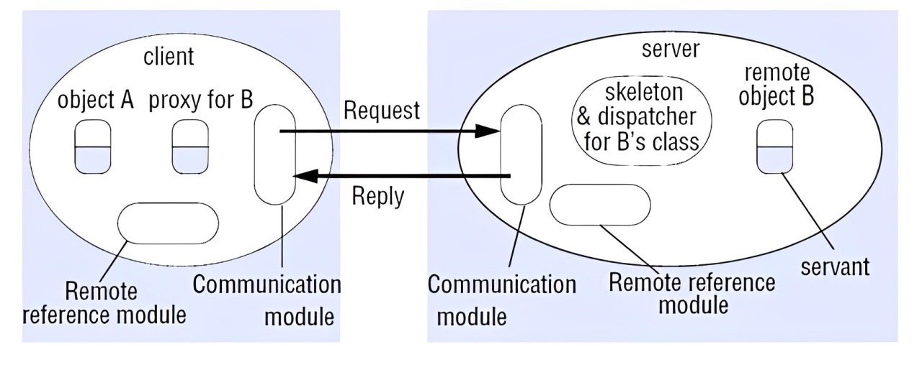
Implementation(cont’d)

Slide 19
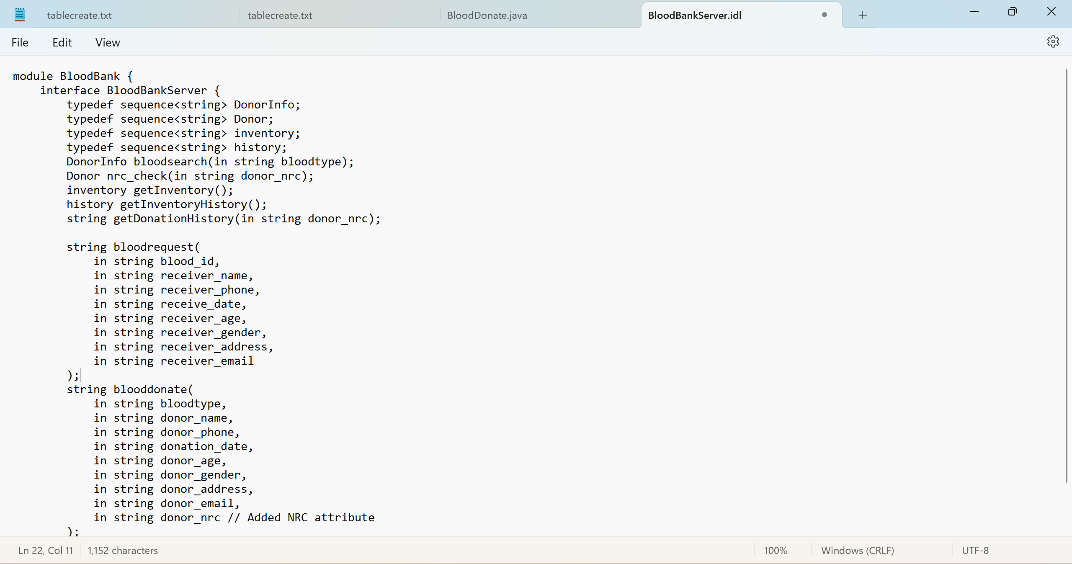
Implementation(cont’d)
Figure: BloodBankServer.idl File for CORBA Interface Definition

Slide 20
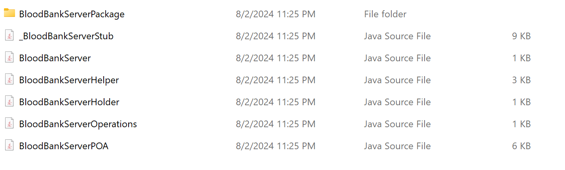
Implementation(cont’d)
Figure: Stub and Skeleton Classes Generated by idlj Compiler

Slide 21
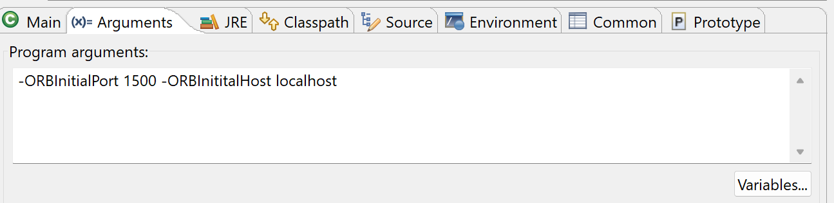

Implementation(cont’d)
Figure: ORB and Naming Service Initialization

Slide 22
Conclusion
Blood Donation System
Address Critical Need: Provide essential blood for emergencies, surgeries, and chronic illness treatment.
Save Lives: Facilitate life-saving blood donations daily.
Ensure Safety: Maintain a quick and safe donation process with stringent protocols.
Encourage Regular Donations: Maintain a stable blood supply through consistent contributions.
Streamline Management: Optimize the handling of donations and requests efficiently.

Slide 23
References
“Distributed Systems Concepts and Design”, by George Coulouris, Jean Dollimore, Tim Kindberg and Gordon Blair, 5th Edition, ISBN-10: 0-13-214301-1
https://www.ibm.com/docs/en/integration-bus/10.0?topic=corba-common-object-request-broker-architecture
https://docs.oracle.com/javase/8/docs/technotes/guides/idl/corba.html
https://www.w3computing.com/articles/java-remote-method-invocation-rmi/

Slide 24
Thank You

